Slide 1
Enhancing Enterprise Project Management through Collaboration
BP014
Ben Chamberlain/Doug Mcutcheon
Senior Product Managers – Project PMG
Microsoft Corporation

Slide 2
Why Are You Here? Key takeaways
Now is a great time to be a Project / EPM Partner
The Future is Bright
Seize the opportunity now

Slide 3

Agenda
Project Management Evolution
Can PPM Help Today?
Project Management & Collaboration
Innovation Process Management Demo
Microsoft Project 2010
Call to Action

Slide 4





As Old as Time Itself… A tried and tested discipline
Where would we be without Project Management?

Slide 5







Project Management Evolution Keeping up with the times
(1989) PRINCE method derived from PROMPTII is published by the U.K. Government
(1950s) The Critical path method (CPM) invented
(1960s) Earned Value Management (EVM)
(1969) Project Management Institute (PMI) established
(1986) Six Sigma Methodology
(2000) Portfolio Management Techniques
1910s
1950s
1960s
1970s
1980s
1990s
2000s
(1861–1919) The Gantt Chart developed by Henry Laurence Gantt
(1958) The Program Evaluation and Review Technique (PERT) method invented
(1975) PROMPTII methodology created by Simpact Systems
(1987) First PMBOK Guide published
(1995) Agile Project Management

Slide 6


In Our Lifetime… Technology has fueled recent evolution
2009
Technology and customer requirements = Change
1980
Financial Management
Resource Management
1980
Scheduling
Resource Tracking
Portfolio Management
Reporting
Simple Reporting
Print
Program Management
Project Collaboration
Task Management

Slide 7


Is PPM Relevant in a Recession? The economic crisis requires a different approach
We are facing tough times
Global economic crisis
Markets tumble
Credit crunch/fiasco
Consumer confidence shattered
Widespread layoffs across all Industries
Stimulus packages
Can PPM techniques help?

Slide 8
Strike the Right Balance in Varying Economies Successful companies will lay the foundation for growth
Drive Growth
Good Times
Recession
Invest and lay the foundation for future growth
Enhance Efficiency
Reduce Costs

Slide 9
Why Invest in PPM I am sure you have heard this 100 times
 |  | Cost Reduction | Enhance Efficiency | Drive Growth
Alignment | Enhance strategic alignment and drive ROI | a | a | a
Governance | Improve accountability, time to market and project success rates | a | a | a
Consolidate | Capture and standardize all requests in a central repository and minimize waste | a | a
Utilization | Effectively utilize available resources and budgets | a | a
Productivity | Use familiar productivity tools to enhance team collaboration and improve execution | a | a | a
Automation | Automate activities that currently require human intervention (e.g. report generation etc.) | a | a
Visibility | Provide the right information at the right time (e.g. executive reporting) | a | a
Control | Identify, correct or eliminate failing projects | a | a | a
Integration | Seamless integration with LoB applications and adherence to enterprise architecture / standards | a | a

Slide 10



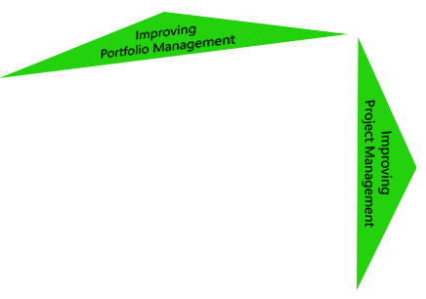


Select and Deliver the Right Things Drive efficiency and growth
100%
Value from Portfolio Management
0%
100%
Value from Project Management

Slide 11
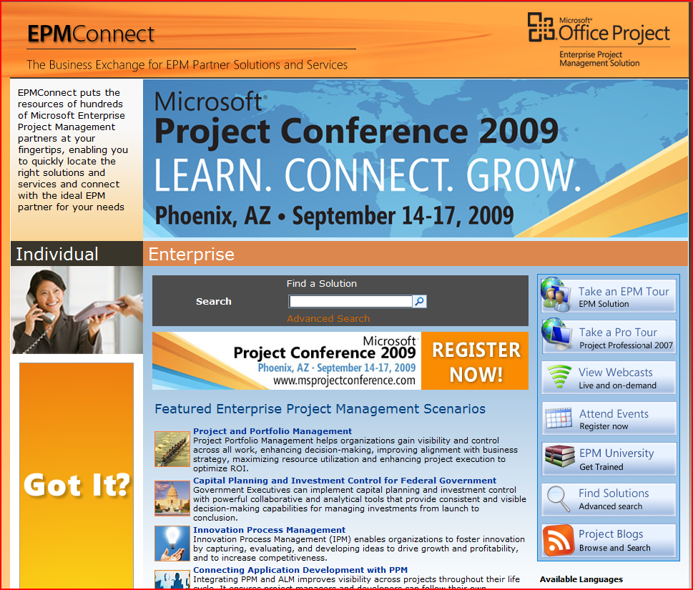
New EPM Solutions Learn more on www.epmconnect.com
Project Portfolio Management (PPM)
Innovation Process Management (IPM)
Cost Reduction
Operational Efficiency
Capital Planning and Investment Control
Application Life-cycle Management (ALM)
Growth and Performance

Slide 12






Project Manager’s Top of Mind Collaboration drives effective execution
Collaboration
Budget
Quality
Schedule
Work

Slide 13



The Next Phase of Evolution Separate but interrelated productivity disciplines
Demand Management
Governance Workflow
Collaboration Services
Project and Portfolio Management
Business Process and Forms
Business Intelligence
Resource Management
Portfolio Selection
Enterprise Content Management
Financial Management
Schedule Management
Enterprise Search
Program Management
Social Computing
Portal
Status Reporting
Team Collaboration
Dashboards & Reporting

Slide 14
The Next Phase of Evolution Separate but interrelated productivity disciplines
Project and Portfolio Management
Collaboration Services
Governance Workflow
Demand Management
Portfolio Selection
Financial Management
Program Management
Team Collaboration
Resource Management
Schedule Management
Status Reporting
Dashboards & Reporting
Business Process & Forms
Social Computing
Workspaces
Enterprise Search
Enterprise Content Mgmt
Portal
Structured PPM organization looking to improve collaboration?
Unstructured PM organization looking to mature to full Project Portfolio Management?

Slide 15
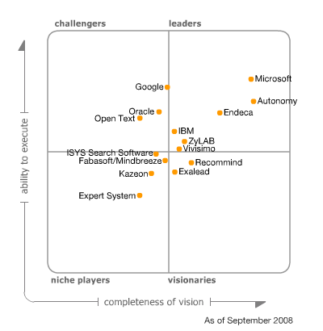
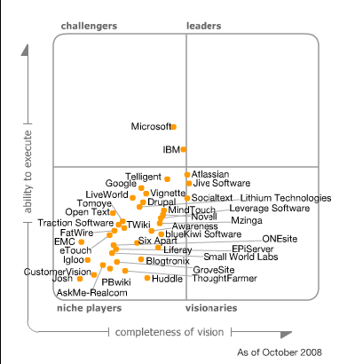
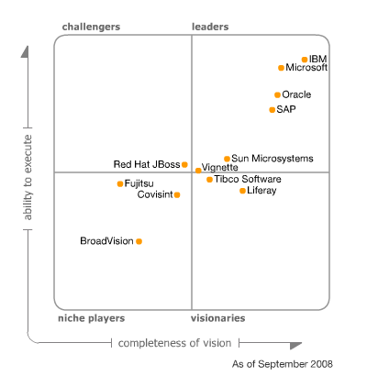
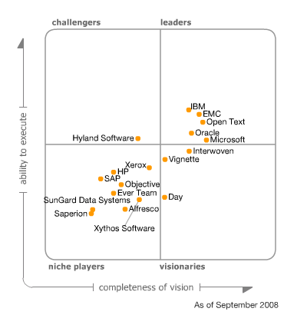
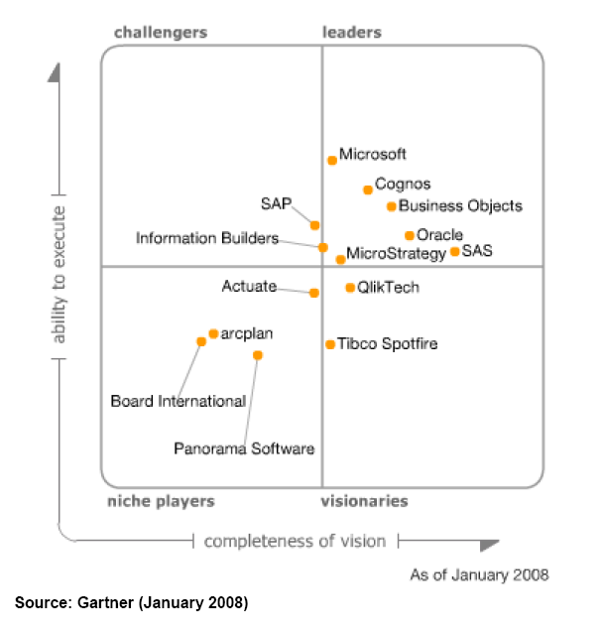
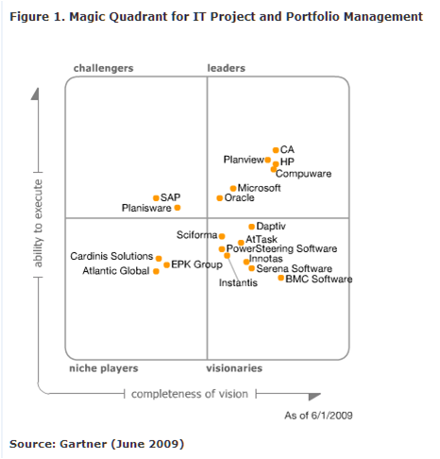
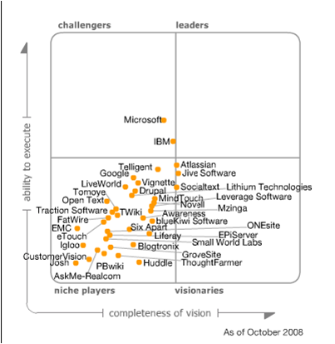
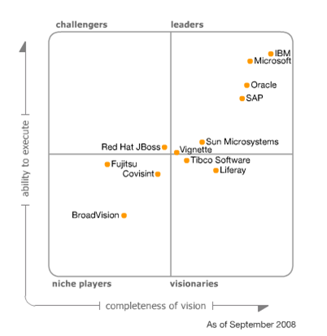
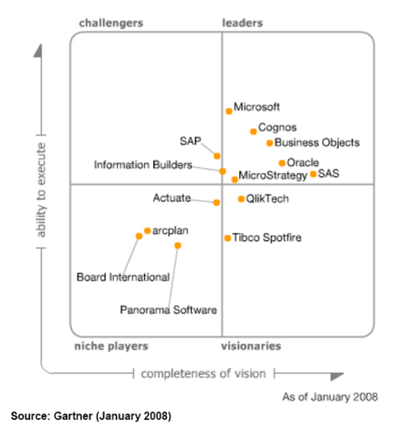
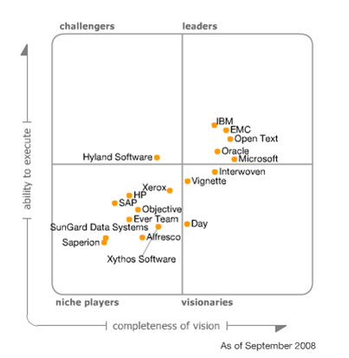
Positioned in Leaders Quadrant in Gartner Magic Quadrants Strength in Both Disciplines
Horizontal Portal Products
ECM
Information Access Technology
Business Intelligence Platforms
PPM
Social Software
Social Software
ECM
Portal
Business Intelligence Platforms
Information Access Technolog
The Magic Quadrant is copyrighted September 12, 23, and 30, 2008 by Gartner, Inc. and is reused with permission. The Magic Quadrant is a graphical representation of a marketplace at and for a specific time period. It depicts Gartner's analysis of how certain vendors measure against criteria for that marketplace, as defined by Gartner. Gartner does not endorse any vendor, product or service depicted in the Magic Quadrant, and does not advise technology users to select only those vendors placed in the "Leaders" quadrant. The Magic Quadrant is intended solely as a research tool, and is not meant to be a specific guide to action. Gartner disclaims all warranties, express or implied, with respect to this research, including any warranties of merchantability or fitness for a particular purpose The Magic Quadrant graphic was published by Gartner, Inc., as part of a larger research note and should be evaluated in the context of the entire report. The Gartner report is available upon request from Microsoft
“Magic Quadrant for Horizontal Portal Products” by David Gootzit, Gene Phifer, Ray Valdes, September 12, 2008
“Magic Quadrant for Enterprise Content Management” by Karen Shegda, Toby Bell, Kenneth Chin, Mark Gilbert, Mick MacComascaigh, September 23, 2008
“Magic Quadrant for Social Software, 2008” by Nikos Drakos, Anthony Bradley, Jeffrey Mann, October 31, 2008.
“Magic Quadrant for Horizontal Portal Products” by David Gootzit, Gene Phifer, Ray Valdes, September 12, 2008
“Magic Quadrant for Business Intelligence Platforms, 2008” by James Richardson, Kurt Schlegel, Bill Hostmann, Neil McMurchy, February 1, 2008.

Slide 16


Get More Value From the Microsoft Platform Build Powerful Solutions
Consistent User Interface
Business Process
Innovation Process Management
Project Portfolio Management
Application Life-Cycle Management
Investment Governance
Project & Portfolio Management Capabilities
Demand Management
Resource Management
Portfolio Analytics
Governance Workflow
Schedule Management
Reporting
Portfolio Selection
Financial Management
Program Management
Collaboration Services
Business Process and Forms
Enterprise Content Management
Business Insight
Collaborative Workspaces
Social Computing
Enterprise Search
Portal
Demand Management
Plan and Execute
Business Insight

Slide 17











Innovation Process Management (IPM)
Capture
Formulate
Evaluate
Define
Select
Unstructured Collaboration
Structured Collaboration

Slide 18
Innovation Process Management (IPM)
demo
Transform Business Performance

Slide 19




Build the Right Solutions Your creativity and ingenuity will drive results
Powerful Tools
Partner Creativity
Relevant Business Solutions
Satisfied Customers
IPM
+
=
ALM
&
SharePoint
CPIC
PPM
EPM

Slide 20

Take A Look At The New EPM Solutions Demonstrate Business Value
Project Portfolio Management (PPM)
Innovation Process Management (IPM)
Capital Planning & Investment Control
Application Life-Cycle Management (ALM)
www.epmconnect.com

Slide 21
Project 2010 Investment Areas Building on the Project 2007 foundation
Common user experience across PPM lifecycle
Improved Demand Management
Better Reporting and BI
Integration with SharePoint Server 2010
Workgroup Collaboration
Enhanced Time/Status Tracking
Improve Execution with Effective Collaboration
Enhance User Experience and Appeal
Choose the right tools that can evolve with you
Unify Project and Portfolio Management
New User Interface
User Controlled Scheduling
Powerful New Views
Web-Based Project Editing
Exchange & TFS Integration
64-Bit Compatibility
No ActiveX Dependency
Simplify Deployment and Extend Interoperability

Slide 22
Key Takeaways
Now is a great time to be a Project / EPM Partner
Positive Product, Customer and Analyst momentum
PPM Value Prop in current economic environment
SharePoint momentum competitive advantage for EPM
The Future is BrightPPM software market forecasted to grow faster than IT and Application Software spend
Investments Project 2010 release, arguably the biggest release for Project in a decade!
The introduction of a new Project and Portfolio Competency for partners
Seize the opportunity nowAll EPM Specialized partners invited to private Technical preview for Project 2010
Continued investments in partner sales and marketing programs such as: New Compete tools, EPM Connect, EDGE and Project for Workgroups.
Attend the Project Conference in September, with Free Project 2010 Airlift for partners!
See Microsoft Partner Portal and Doug McCutcheon blog for latest updates.

Slide 23
Call to Action(s)
Either
Specialize in both worlds
Be a EPM Specialized and SharePoint Specialized Partner
Partner with a partner
Deploy OOB and Build on top
Attend the 2010 enabling events
Project Conference
SharePoint Conference

Slide 24
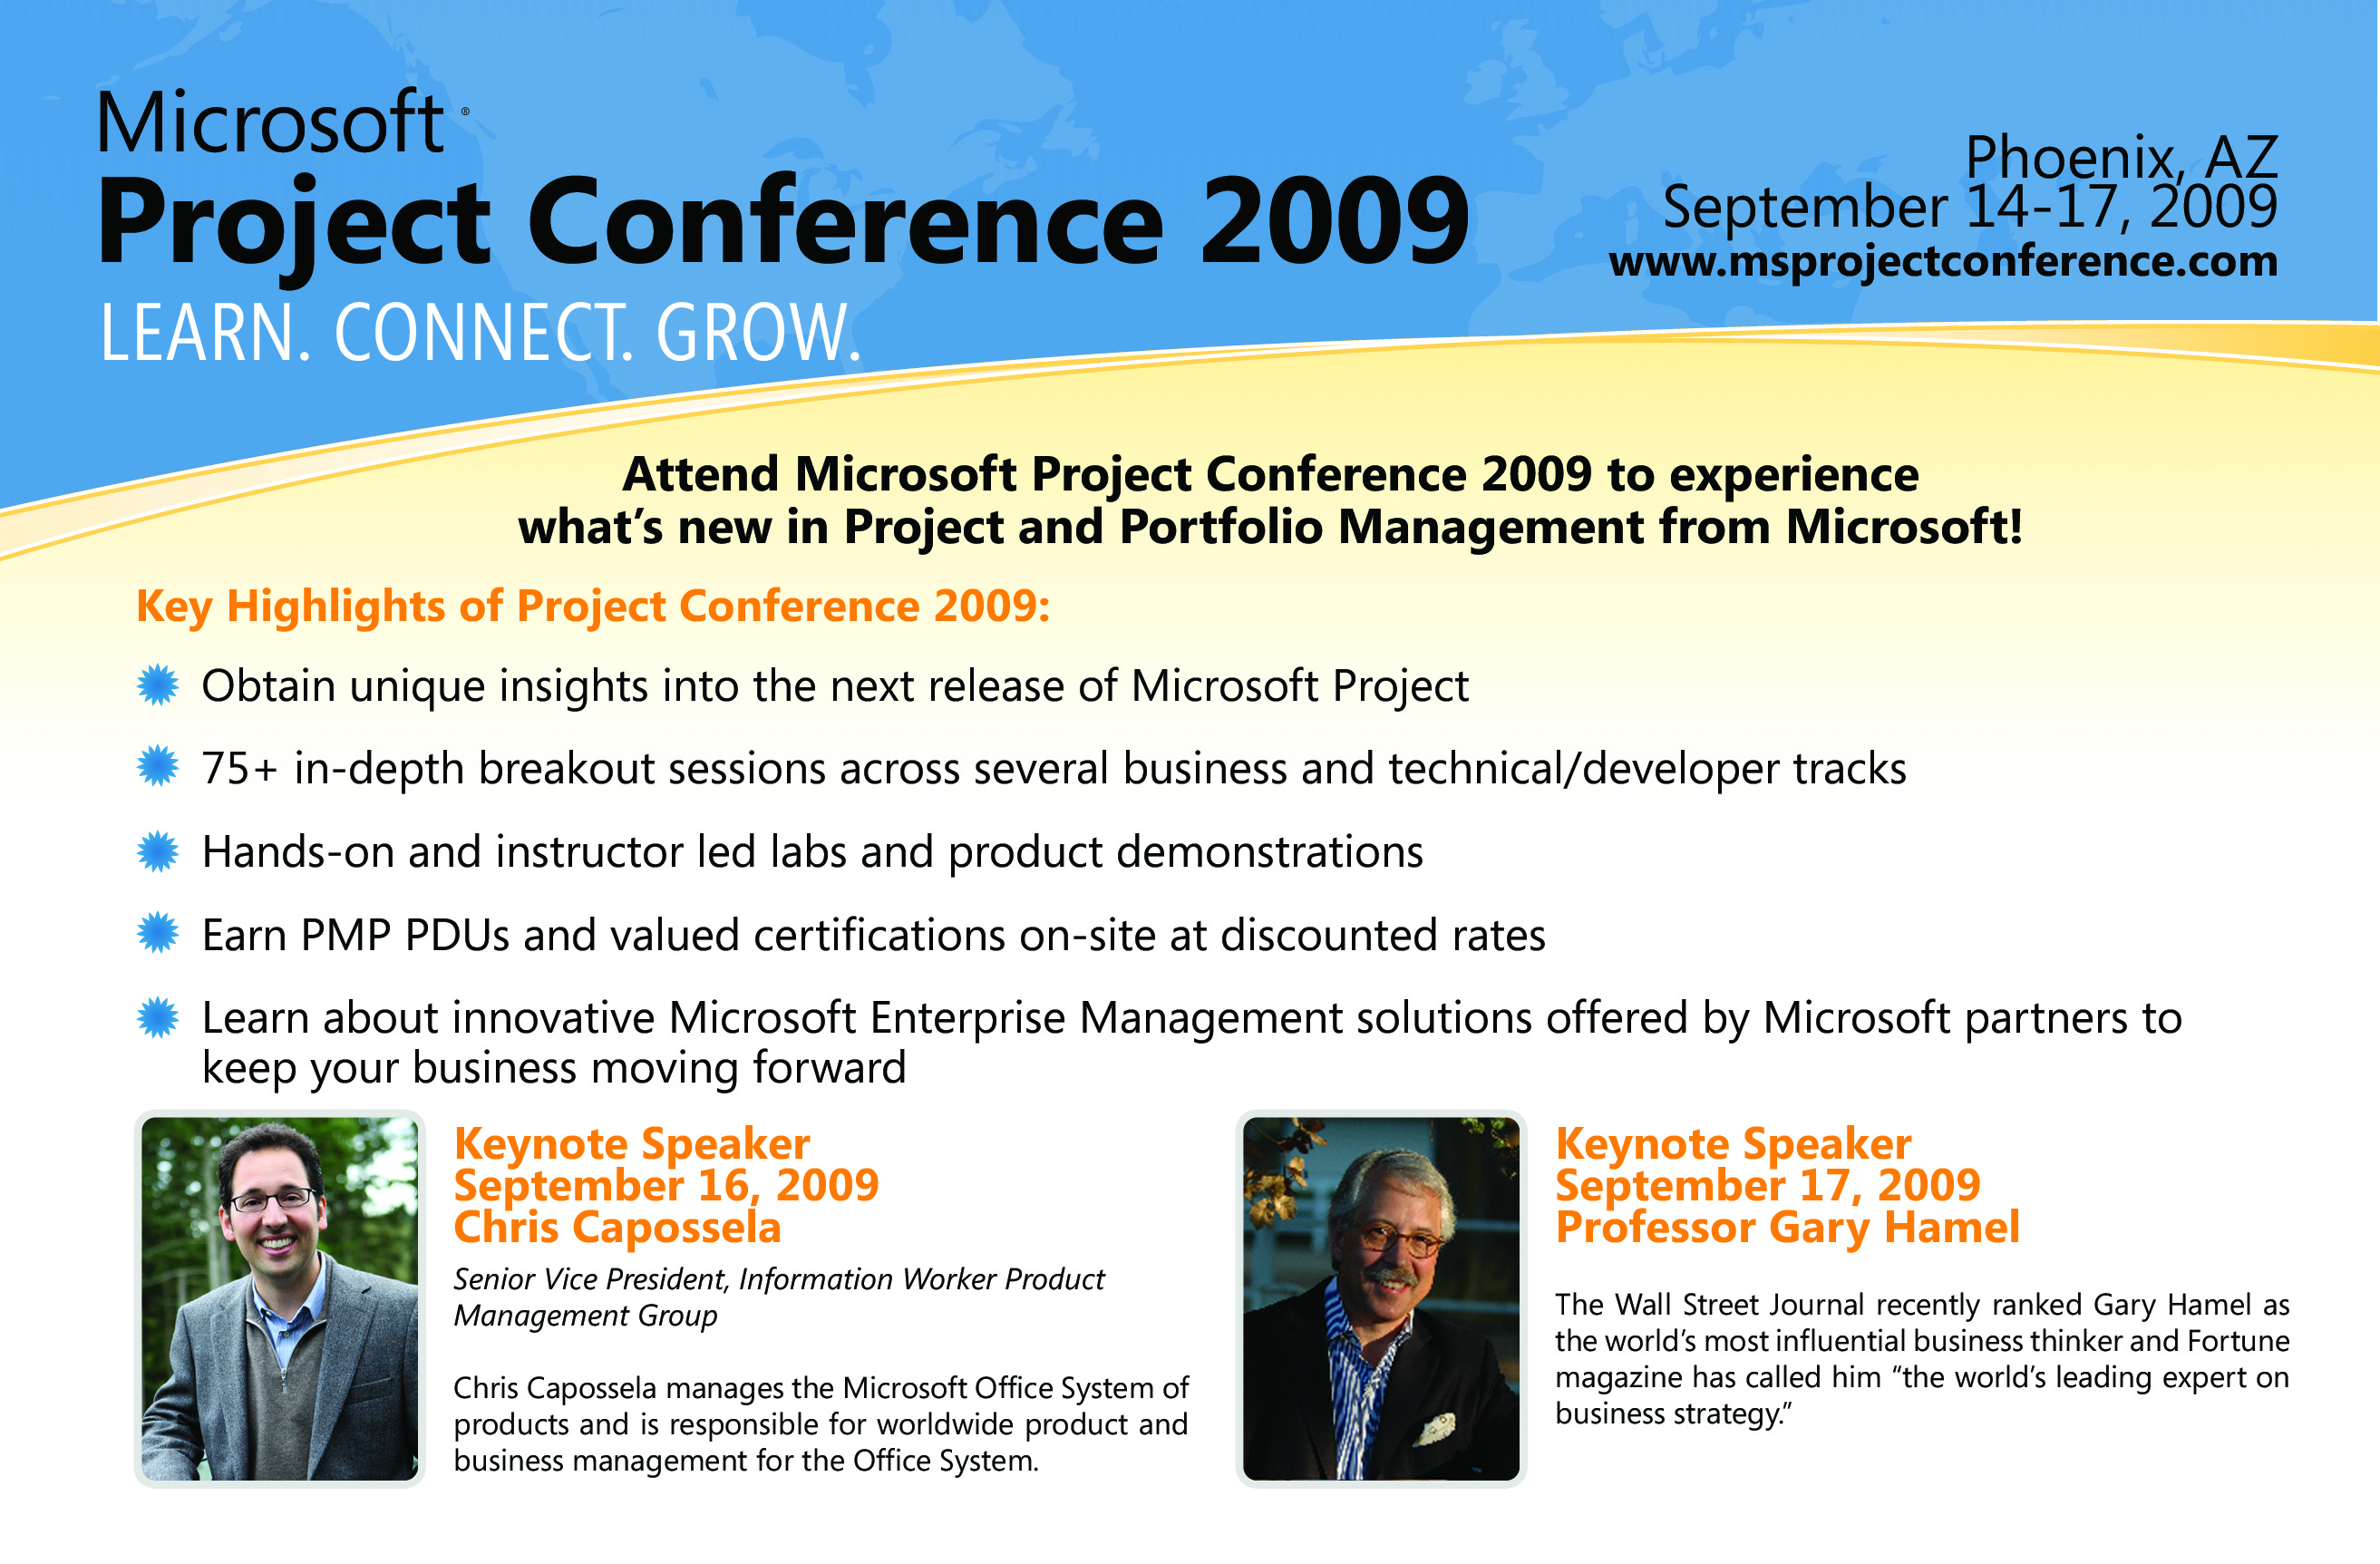

Slide 25
Questions & Answers

Slide 26
THANK YOU!
ALIWARE S.a.s. DI PASTELLI F. & C. Allen Rio Serviços e Comércio de Produtos de Informática Ltda. Allin Consulting Alphamosaik Inc.
Atkins Limited Autocont Cz Brno Automation Associates Inc. Avitus Technologies, LLC Axentro Sp. z o.o.
BEYOND IT S.A. Blackstone & Cullen Inc. Bright Partners Burton Consulting C.O.S Enterprise Management Solutions GmbH
Centro Internacional de Conhecimento Ltd. Cgn & Associates Inc. CHRONOS, Enterprise Solutions Consulting, Ltd. Cms Informatic Concept Micro System Infor
Computer Plus Krakow S.A. Computer Systems Australia Pty Ltd. Consulting firm "MRCB" Consulting group Team
Creuna Denmark A/S CRM Expert Cygnet Training and Consultancy Pvt. Ltd. DATALAB S L
DIGI TRADE DITEC a.s. diventis GmbH Dln Consultoria E Informatica Ltda.
Endero Oy Enterprise Project Management Services EPM Live EPM Solutions, LLC
Experts Projects Management FAI Consulting Services Inc. Fild.NET Sp. z o.o. For3 Consultoria E Treinamento Em Informática Ltda.
Grupo Asesor en Informatica Grupo Beke Santos Guardian Information Systems Ltd. GUIDANCE NV.
IIL_NY Info Tech Ltd. INFO TREK SDN BHD Information Technologies Services SA CV
INTERGRUPO S.A. International Network Services (Headquarters) (Santa Clara) Intersoft Management Systems AS Inversiones y Asesorías COFRE Ltda.
Kelyan-Project.Net KSOB LBMS, s.r.o. Leader Group leadproject.pl s.c. Klaudiusz Pelc i Marcin Bąk
MarketBridge Matan Computers Operation & Management Metier AS Microsoft Australia Pty Ltd. Primary
Microsoft: Gold – AdvInfra(ms) Milestone Consulting Group Inc. Modul 1 Data AB Monere Business, S.C.
NEW VISION CONSULTING GROUP Novared Oakwood Systems Group Inc. Oficina de Proyectos Empresariales S.L.
Project Solutions Group, Inc. Project Solutions International (Thailand) Projectum Aps Projility, Inc.
QUANTUMPM LLC Quart it. REDCOM CIBERNETICO Renke Holert
Safran Software Solutions AS Schwab Projektmanagement Segawas Projetos, Treinamento e Informática Ltda. SEQUENCE ADVISORS
Sogeti Suisse SOGETI USA Soho Corp. dba MSProjectExperts Solosoft Ltda.
Technology Associates Technology World Company TEKORA TENROX The Project Group GmbH
Twice Training B.V. UMT Consulting Group UMT Project and Portfolio Management Services South Africa (Pty) Ltd. Vertscape, Inc.
Wodey Informationssysteme Xcelligent LLC ZAO Bogdanov and Associates ООО "Бастион"
Portfolio Project Management Inc. Process IT Program Framework Progressive IT
Arvato Direct Services (SMB) ASAE CONSULTORES S.A. DE C.V. Assure Consulting GmbH Astra Asesoria Y Transformacion, Sa De Cv
Azevedo & Luz Ltda. Babbage Simmel & Associates Inc. BCA Serviços de Informatica Ltda. ME Belo Horizonte Sistemas Ltda.
Camako Data Ab Campana & Schott Realisierungsmgmt GmbH CDW Corporation Center of Information & Financial Tech. Centre of Computer Training "Specialist"
CognitiveTechnologies, Inc. COMFRAME SOFTWARE Comp Safe Support SA CompuBase Abu Dhabi Compulink Systems Private Limited
Consulting Resources Group, Inc. Corporate Business Solutions Corporate Project Solutions Ltd. Corporativo ICSI S.A. de C.V.
Datatron DBS Business Solutions BV DC Edukacja sp. z o.o. Designer Technology Limited
Dr. Tertschnig GmbH Ebit Elk ve Blg Ilt Sis Uret Paz Ltd Sti EFTI Emm&mmE Informatica S.r.l.
Epmpartner EPMWorks S.A. Expand Pty Ltd. Expertos En Soluciones Ti, S.C.
Forte Systems Inc. Fujitsu Services AB Gamma Servicios S.A. de C.V. GijimaAst GP3 Groupe Conseil
Hans Torsleff Management Systems Help Technology Highmark Solutions, LLC HMS SOFTWARE
InfoSERVER S.A. INNEO Solutions GmbH InspireTech Sp. z o.o. Intellient Ltd. INTELLIGROUP ASIA LIMITED
IQSOFT-John Bryce Training Center IT Vision Sp. z o.o. ITEC Training & Education Services SA JSR Multi Design
LIFELONG Kuwait LMR SOLUTIONS M7 SA Maestros Mediline Systems Ltd. Maint Cia Ltda.
Microsoft Deutschland Microsoft Deutschland TSC - TEAM Microsoft: All Competencies Microsoft: Certified – IW
MS Project Pros MTS Allstream Inc. Nagnoi, Inc. New Horizons Pakistan (Pvt.) Ltd.
One Fox B.V. Orantech P. Zinger Projects Ltd. Pcubed PIPC Ltd
PROKODA GmbH Provoke Solutions Limited PT SI Quadrus Development Inc.
Resource Management Professionals Robbins Gioia Inc. Rota Bilgi Teknolojileri Danismanlik Hiz
Servicios Internacionales en gestion de productividad, APMS sl Sistemas Expertos Ltda. SoftLine International Software Systems LLC
Solvin Information Management GmbH Sotis Consultoria Ltda. Southern Project Group, Inc. Span d.o.o.
THE VERSATILE COMPANY TIETURI OY TPM Group Trilex Consulting srl Tubedale Ltd.
Viaduk-Telecom Western Principles Wharton Computer Consulting Inc. William George Associates Ltd. Winvision
北京理正软件设计 研究院有限公司 北京神剑网景科技 发展有限公司 富士ソフト株式会社 株式会社テクノプロ ・エンジニアリング
PM CENTRIX PM CONNECT PM Consulting Sevices PM Providers, LLC PM RESOURCE GROUP
Proha Plc Project Assistants Inc. Project Hosts Project Management Practice Inc.
Springhouse Education & Consulting Services ST NEXT SRL STATERA STATWORKS (M) SDN BHD
6D Technologies Incorporated AAJ TECHNOLOGIES ACANDO AB AccTech Systems (Pty) Ltd. Add Technologies ltda
Advisicon Aenigma (U.K.) Ltd. Agora Consulting Partners Inc. Alegri International Service GmbH
PM Sight PMCC PMCS GmbH PMP Specialists, LLC PM-Partners Group
Strategic Data Management PTY Ltd. Supply Chain Management Limitada Systemethod PTE Ltd. Techno Management
Our Partners

Slide 27

© 2009 Microsoft Corporation. All rights reserved. Microsoft, Windows, Windows Vista and other product names are or may be registered trademarks and/or trademarks in the U.S. and/or other countries. The information herein is for informational purposes only and represents the current view of Microsoft Corporation as of the date of this presentation. Because Microsoft must respond to changing market conditions, it should not be interpreted to be a commitment on the part of Microsoft, and Microsoft cannot guarantee the accuracy of any information provided after the date of this presentation. MICROSOFT MAKES NO WARRANTIES, EXPRESS, IMPLIED OR STATUTORY, AS TO THE INFORMATION IN THIS PRESENTATION.

